Slide 1
Programming 101

Slide 2
Programming Intro
HTML
CSS
Java
Script
Algorithm
Searching
Sorting
Final Project
Simple
App

Slide 3
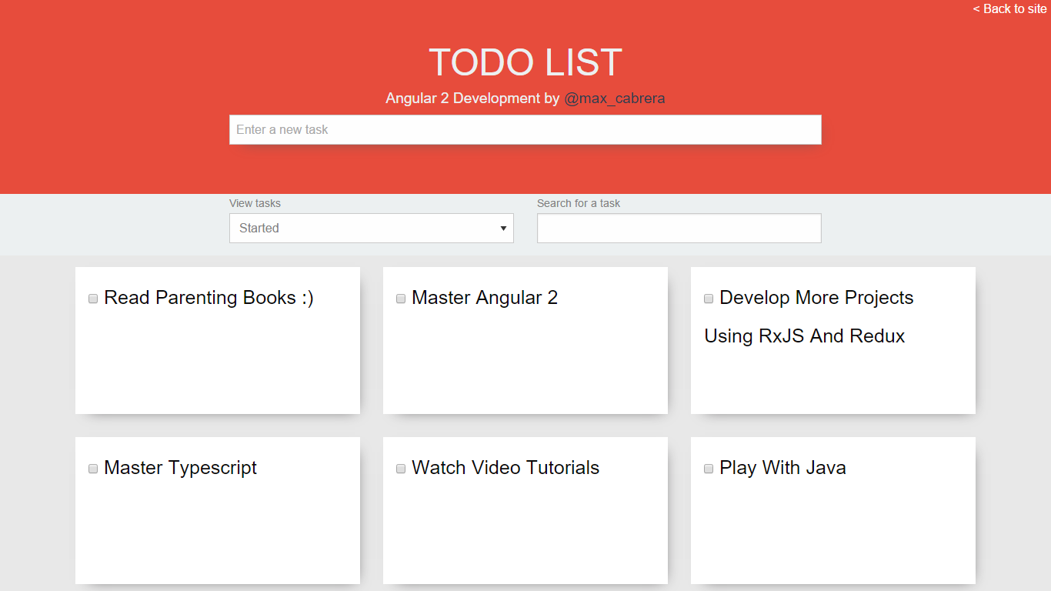
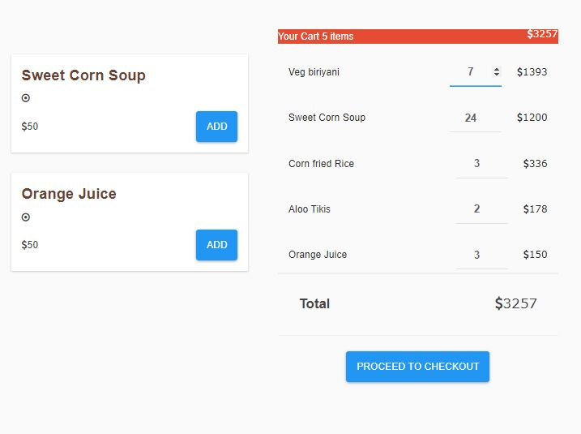

Slide 4
Programming 101 Day 1
Introduction to programming

Slide 5
Outline
Programming Intro
HTML

Slide 6
Programming

Slide 7
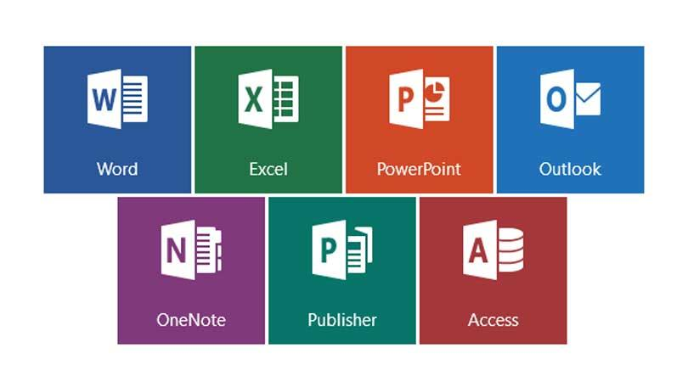





Notes:
Informasi produk hasil pemrograman

Slide 8
“Pemrograman adalah proses menulis, menguji dan memperbaiki (debug), dan memelihara kode yang membangun suatu program komputer”
- Wikipedia
Notes:
Penjelasan definisi pemrograman

Slide 9
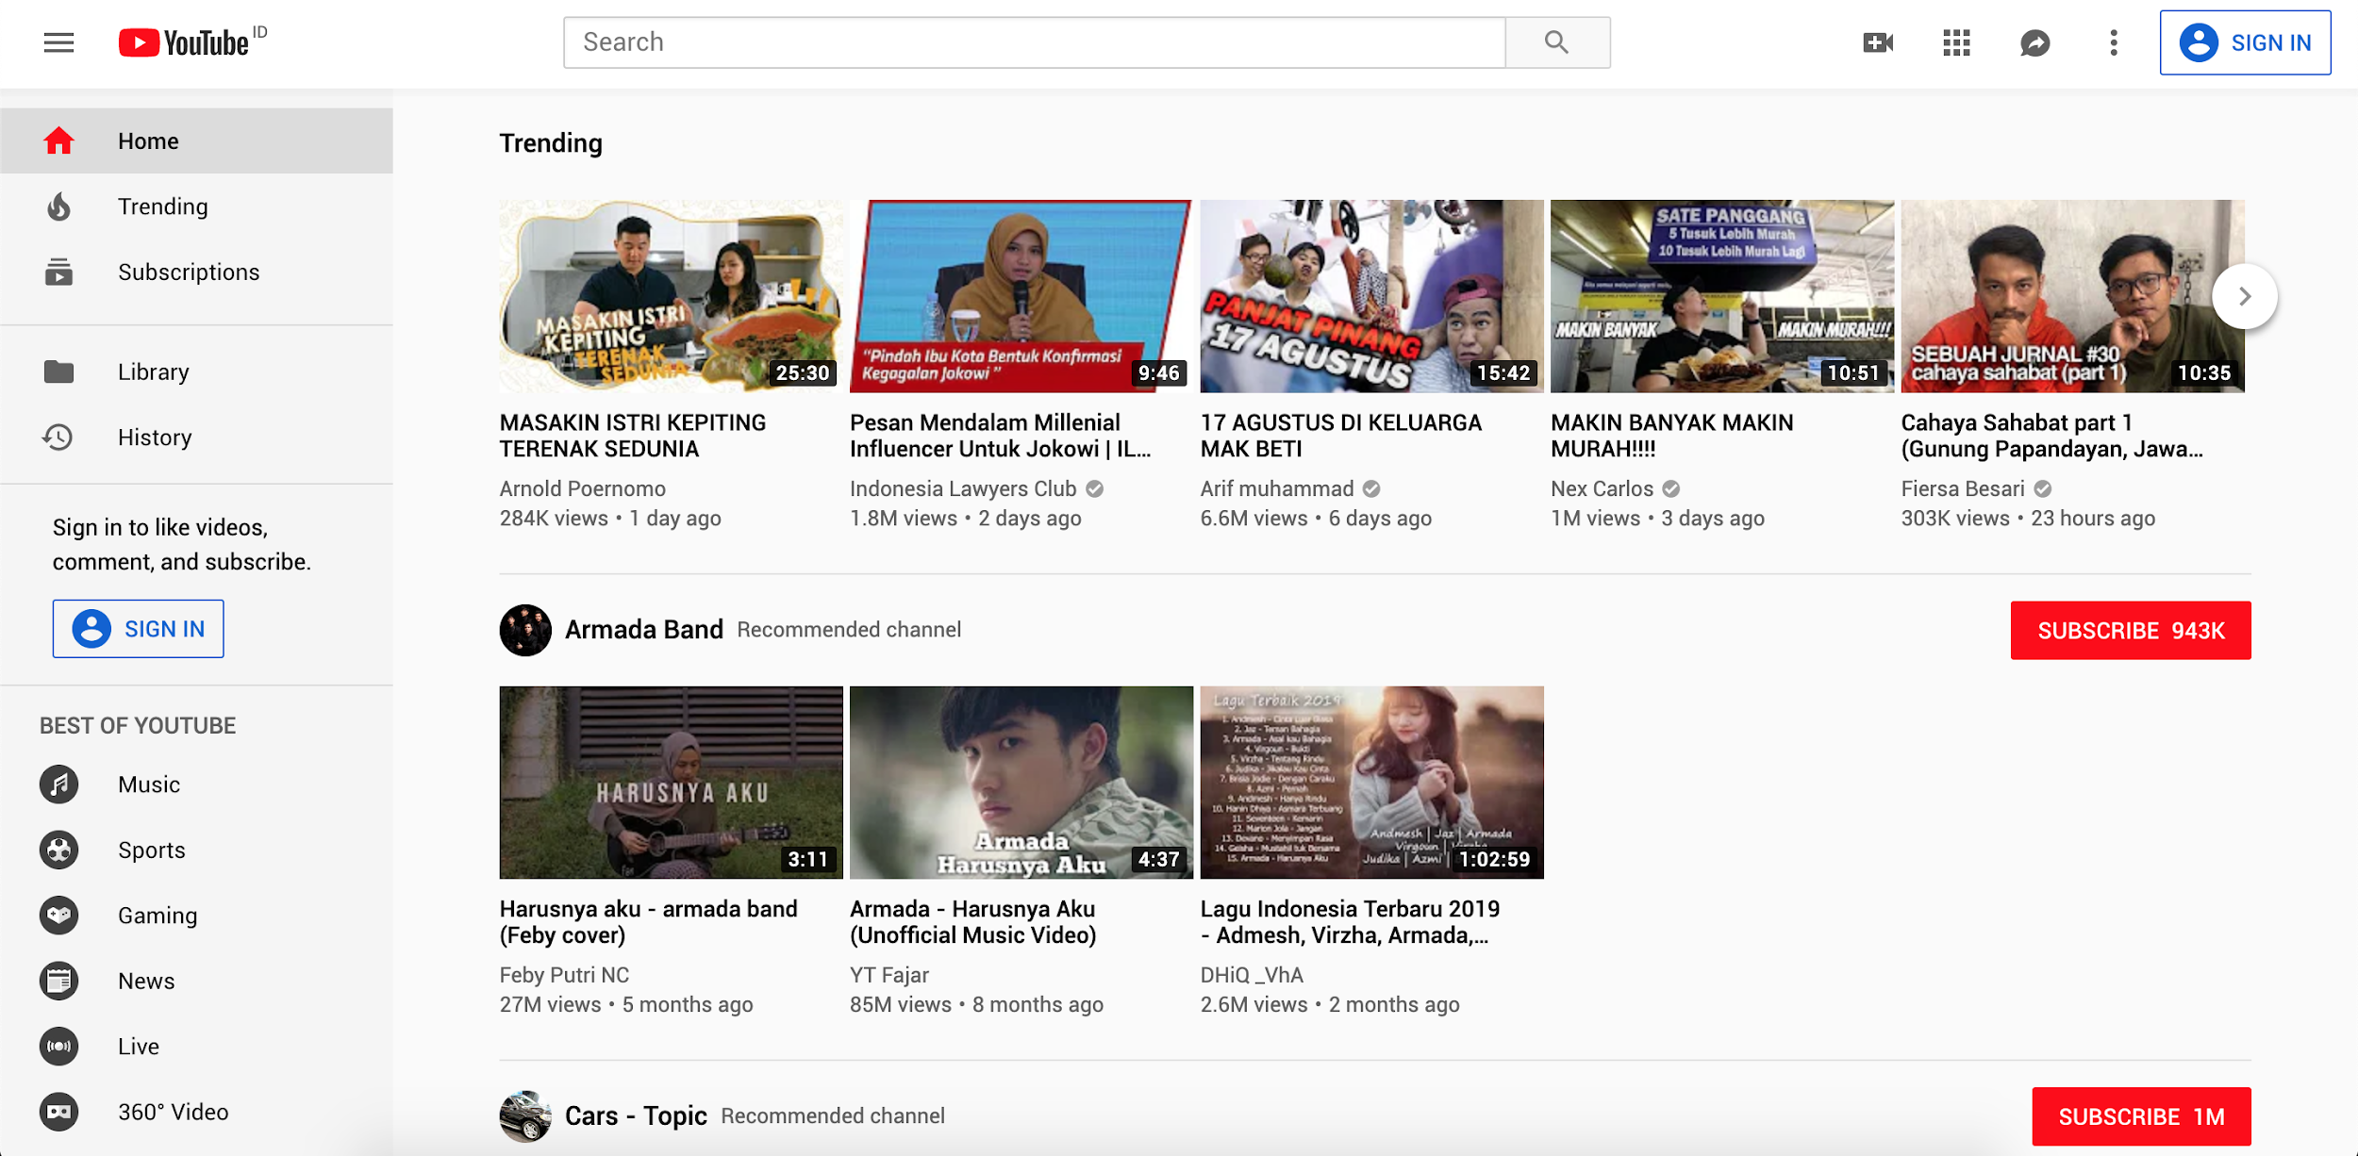
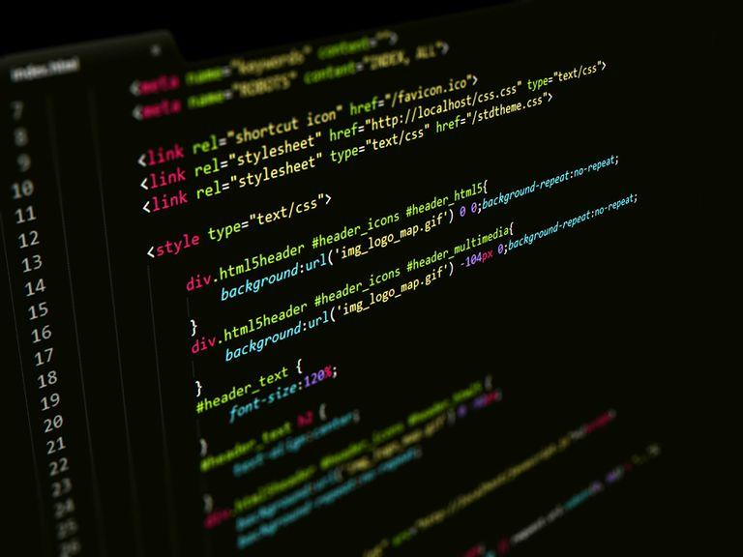

Slide 10
“Pemrograman adalah suatu seni dalam menggunakan satu atau lebih algoritma yang saling berhubungan dengan menggunakan suatu bahasa pemrograman tertentu sehingga menjadi suatu program komputer”
- Wikipedia

Slide 11
“Algoritma adalah prosedur langkah-demi-langkah untuk penghitungan. Algoritma digunakan untuk penghitungan, pemrosesan data, dan penalaran otomatis.”
- Wikipedia

Slide 12
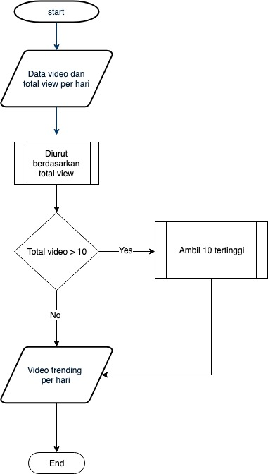
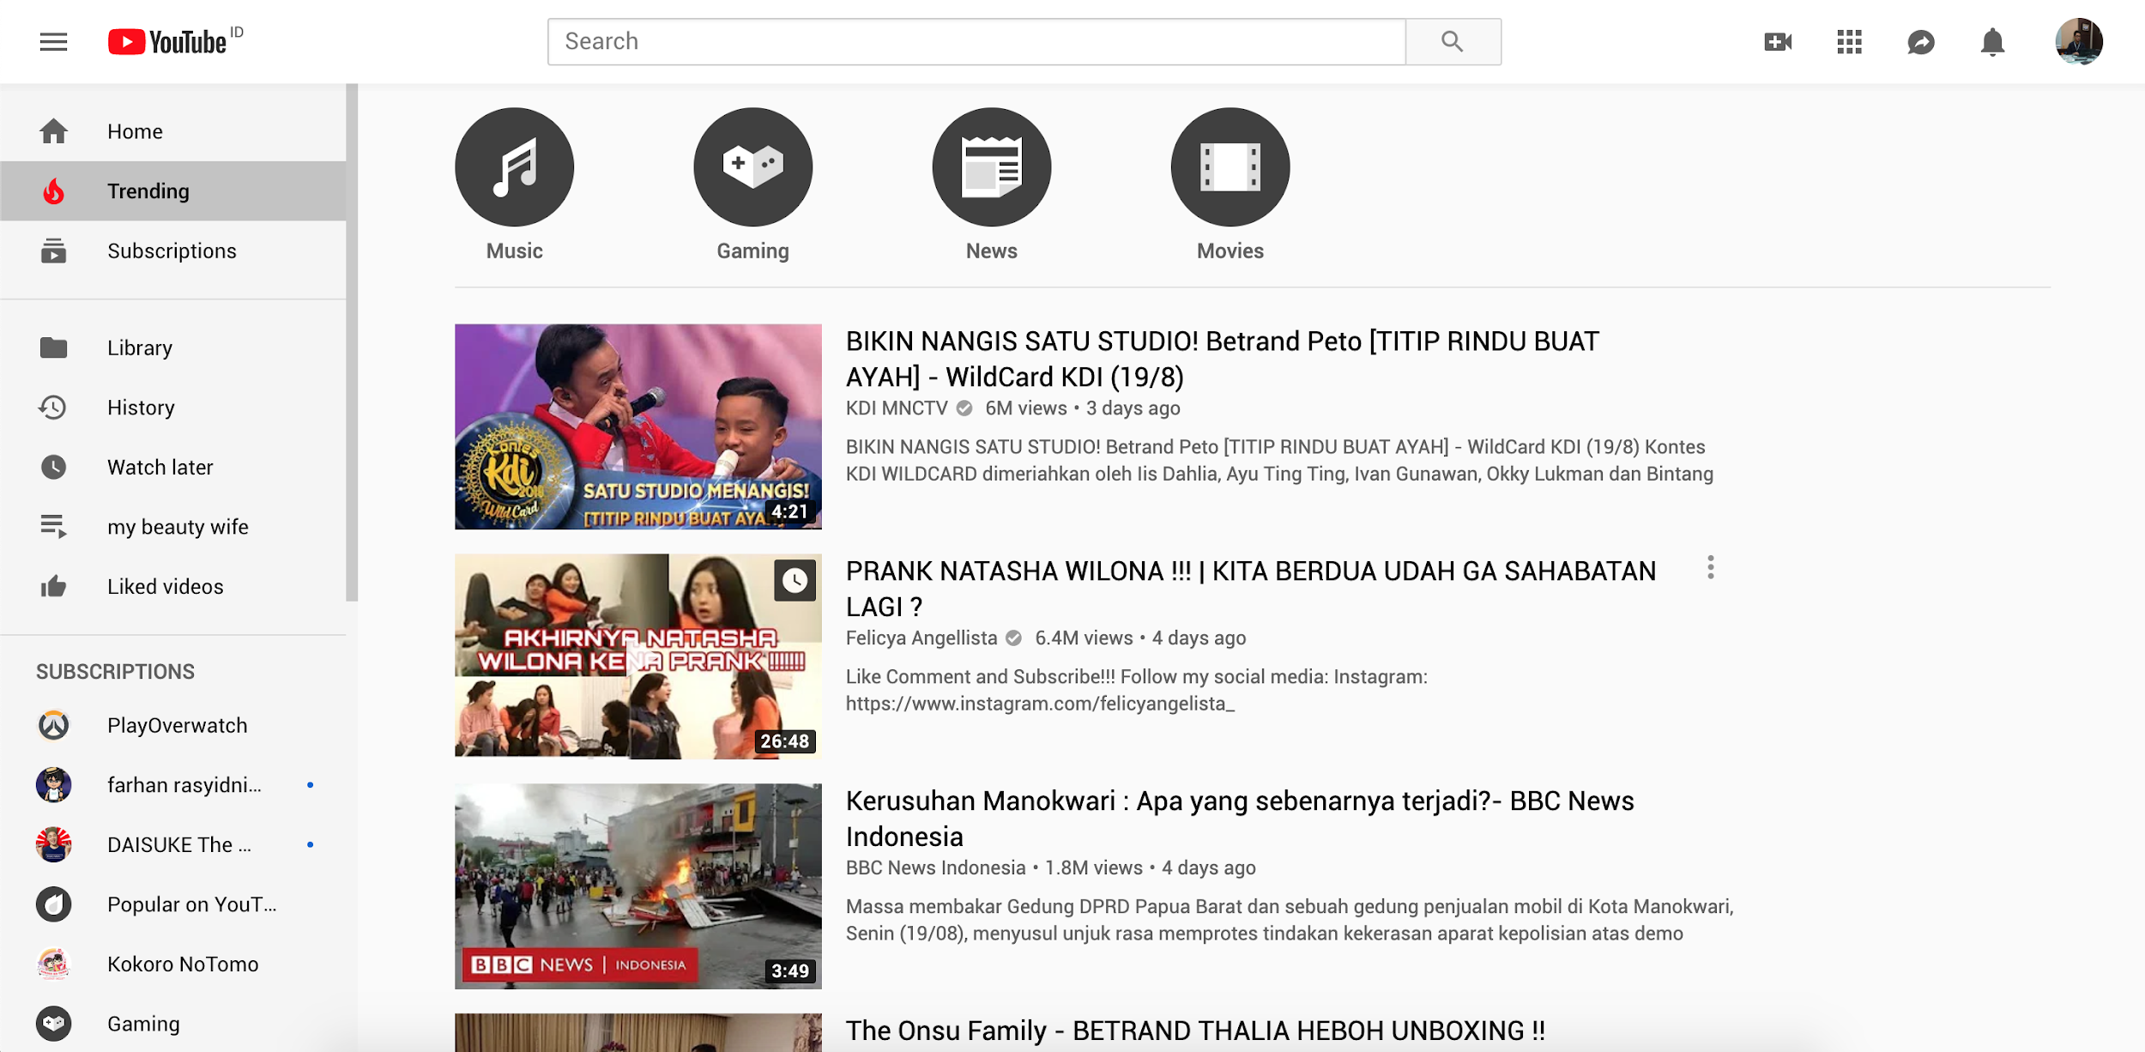
Notes:
Contoh algoritma mencari trending video

Slide 13
Programming Language

Slide 14
“Bahasa pemrograman komputer adalah instruksi standar untuk memerintah komputer”
- Wikipedia

Slide 15
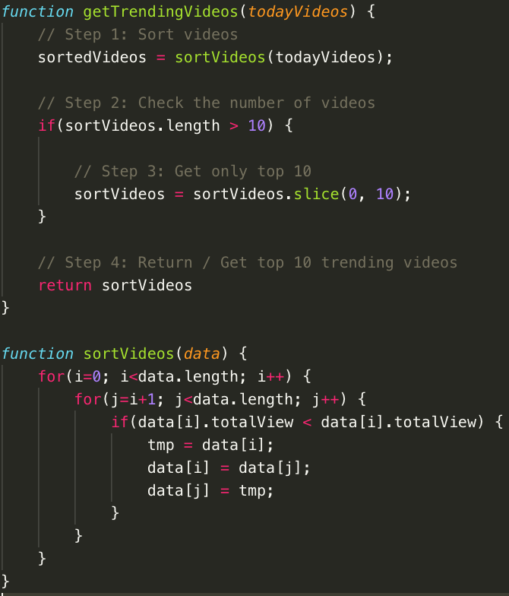
Notes:
Contoh intruksi dalam pemrograman

Slide 16
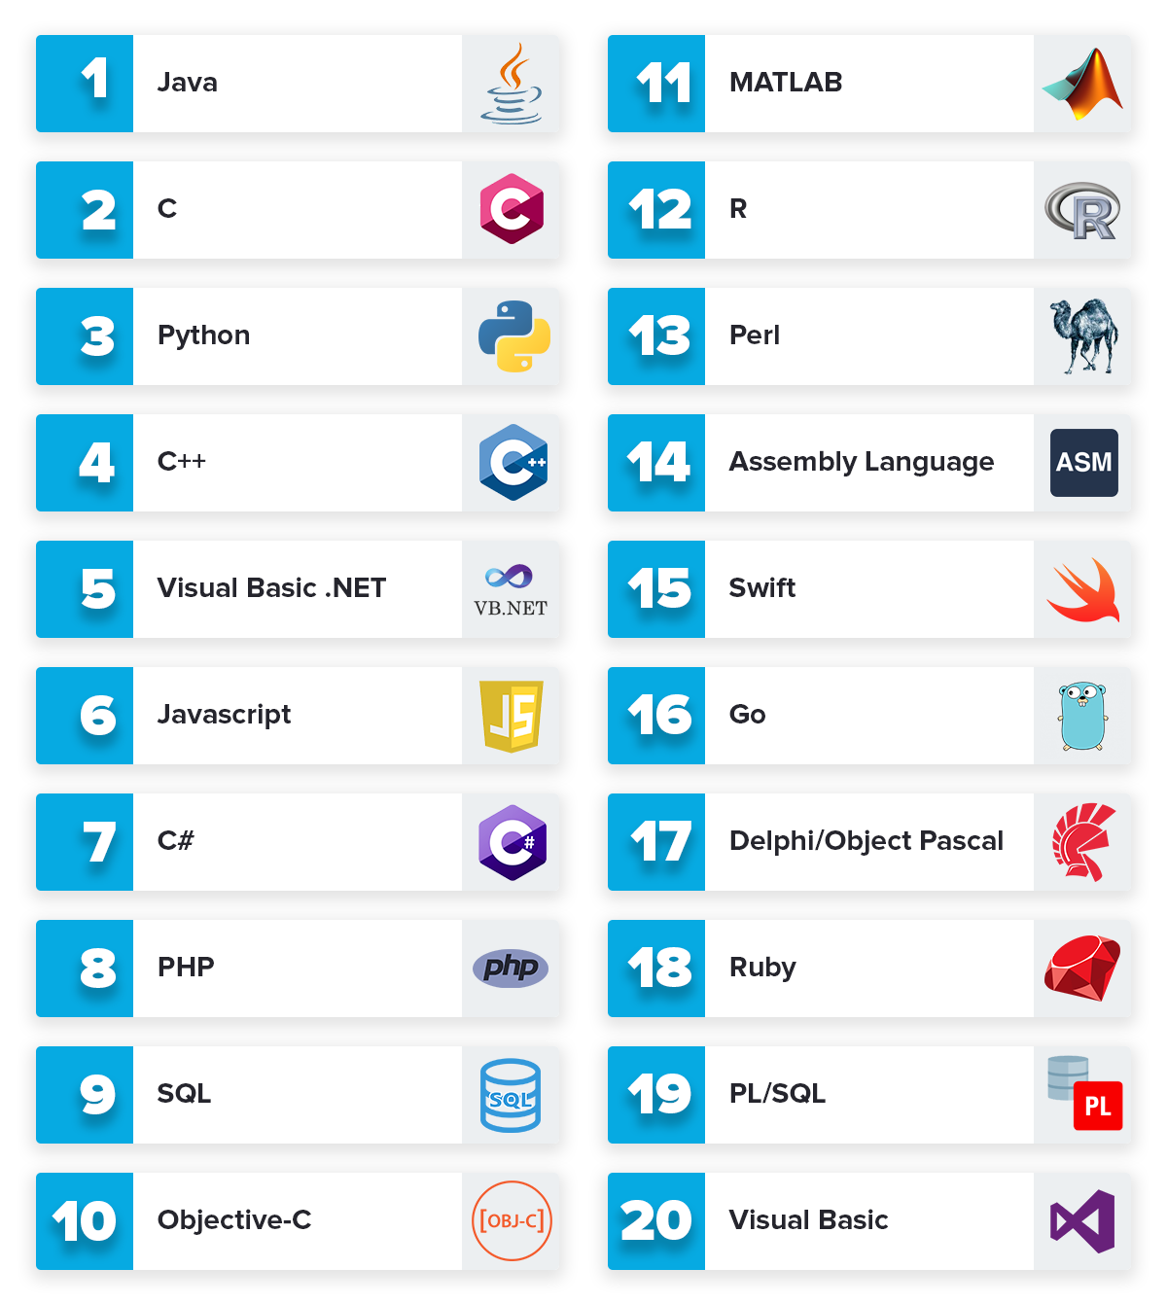
Notes:
Macam-maca bahasa pemrograman

Slide 17
Java Script (JS)

Slide 18
“JavaScript is the programming language of HTML and the Web.”
- w3schools.com

Slide 19
“Hypertext Markup Language (HTML) is the standard markup language for documents designed to be displayed in a web browser. It can be assisted by technologies such as Cascading Style Sheets (CSS) and scripting languages such as JavaScript (JS).”
- Wikipedia

Slide 20
“Cascading Style Sheets (CSS) is a style sheet language used for describing the presentation of a document written in a markup language like HTML.”
- Wikipedia

Slide 21





Slide 22
Requirements

Slide 23

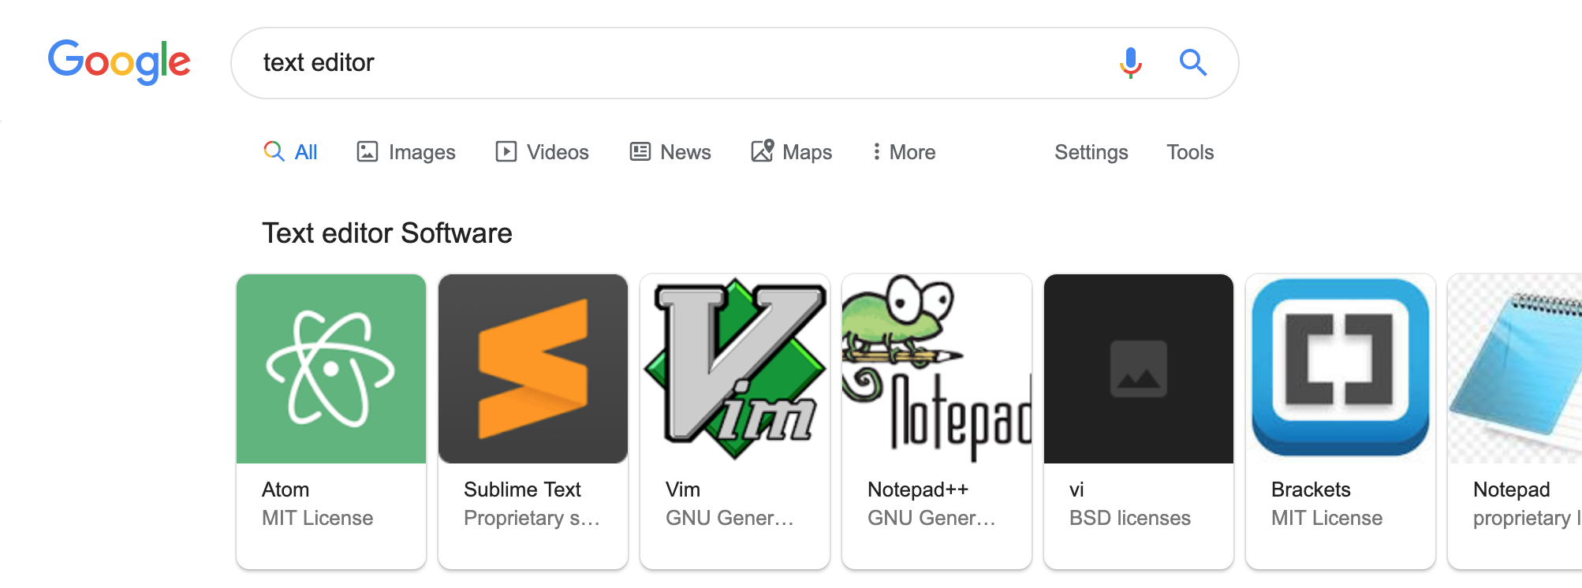

Slide 24
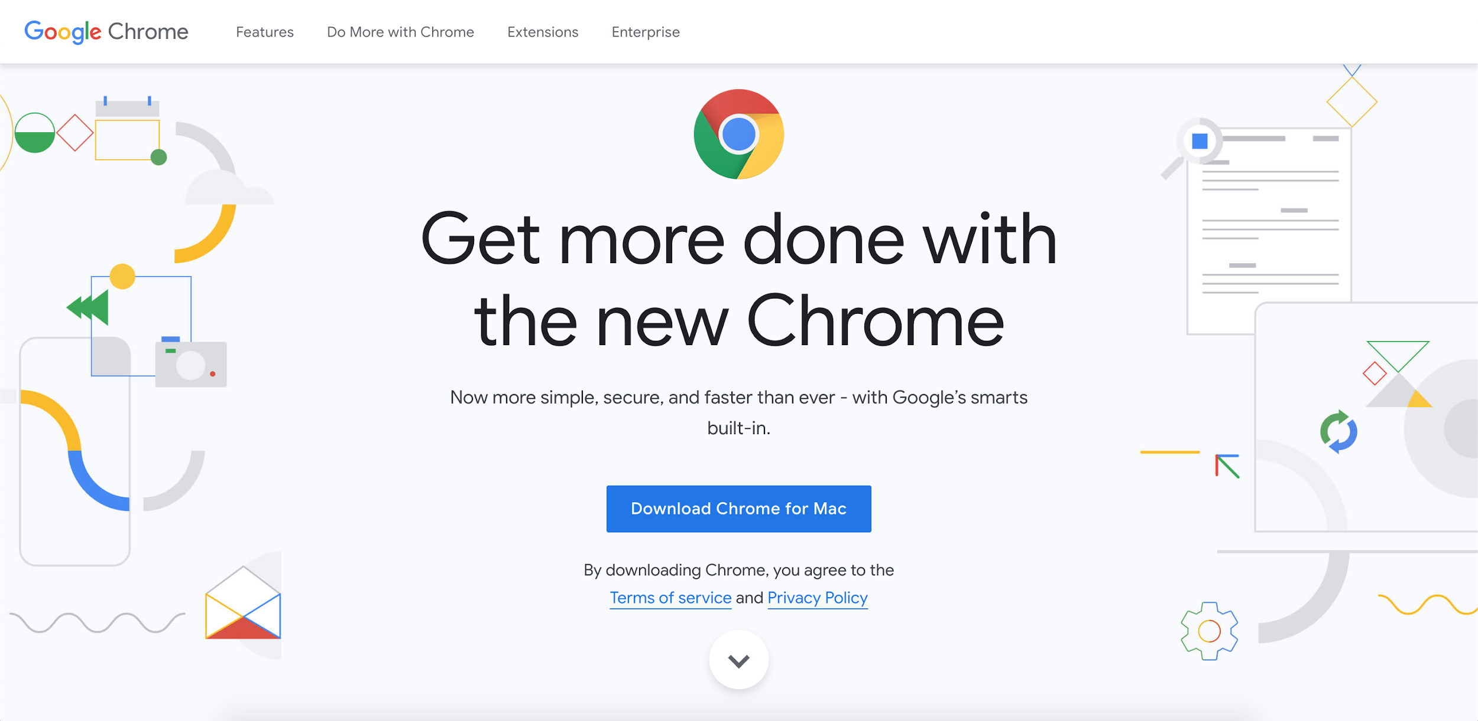
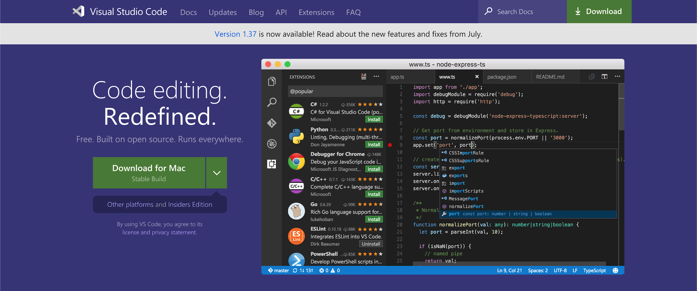
https://www.google.com/chrome/
https://code.visualstudio.com/

Slide 25
Let’s code: “Hello World!”

Slide 26
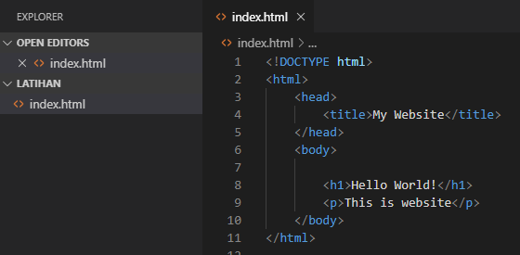
HTML

Slide 27
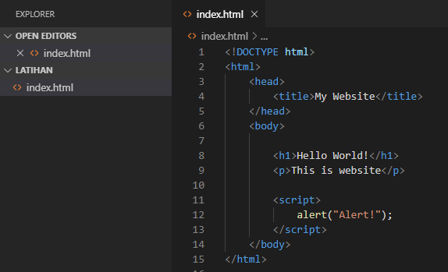
JS Alert

Slide 28
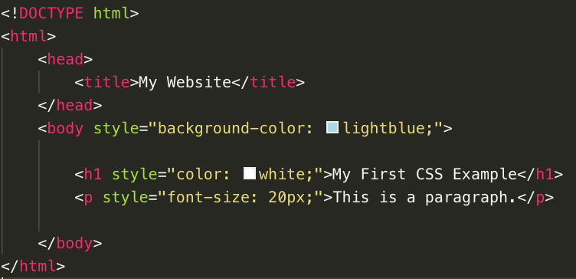
Styling with CSS

Slide 29
HTML

Slide 30
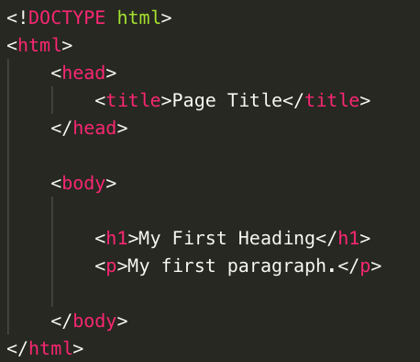
Intro
HTML is the standard markup language for creating Web pages.
HTML stands for Hyper Text Markup Language
HTML describes the structure of a Web page
HTML consists of a series of elements
HTML elements tell the browser how to display the content
HTML elements are represented by tags
HTML tags label pieces of content such as "heading", "paragraph", "table", and so on
Browsers do not display the HTML tags, but use them to render the content of the page

Slide 31
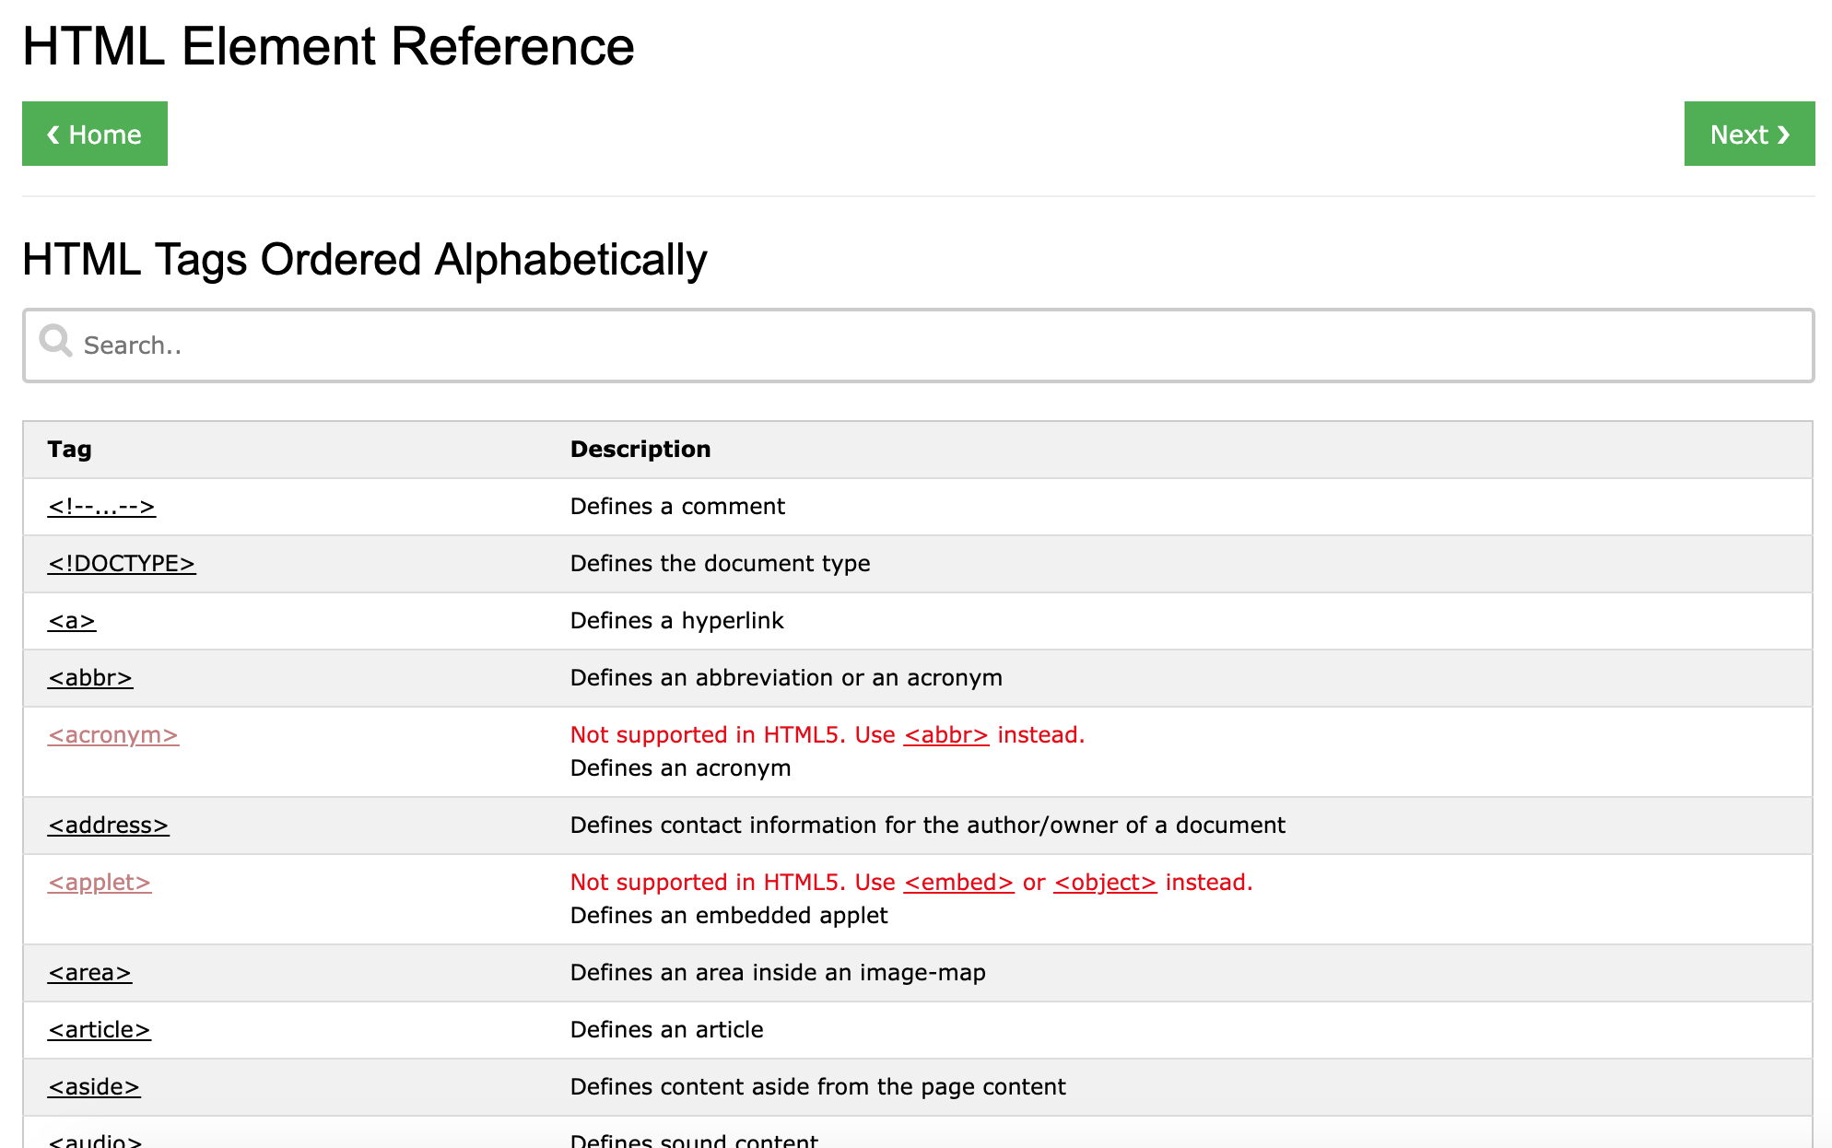
HTML Elements
https://www.w3schools.com/tags/default.asp

Slide 32
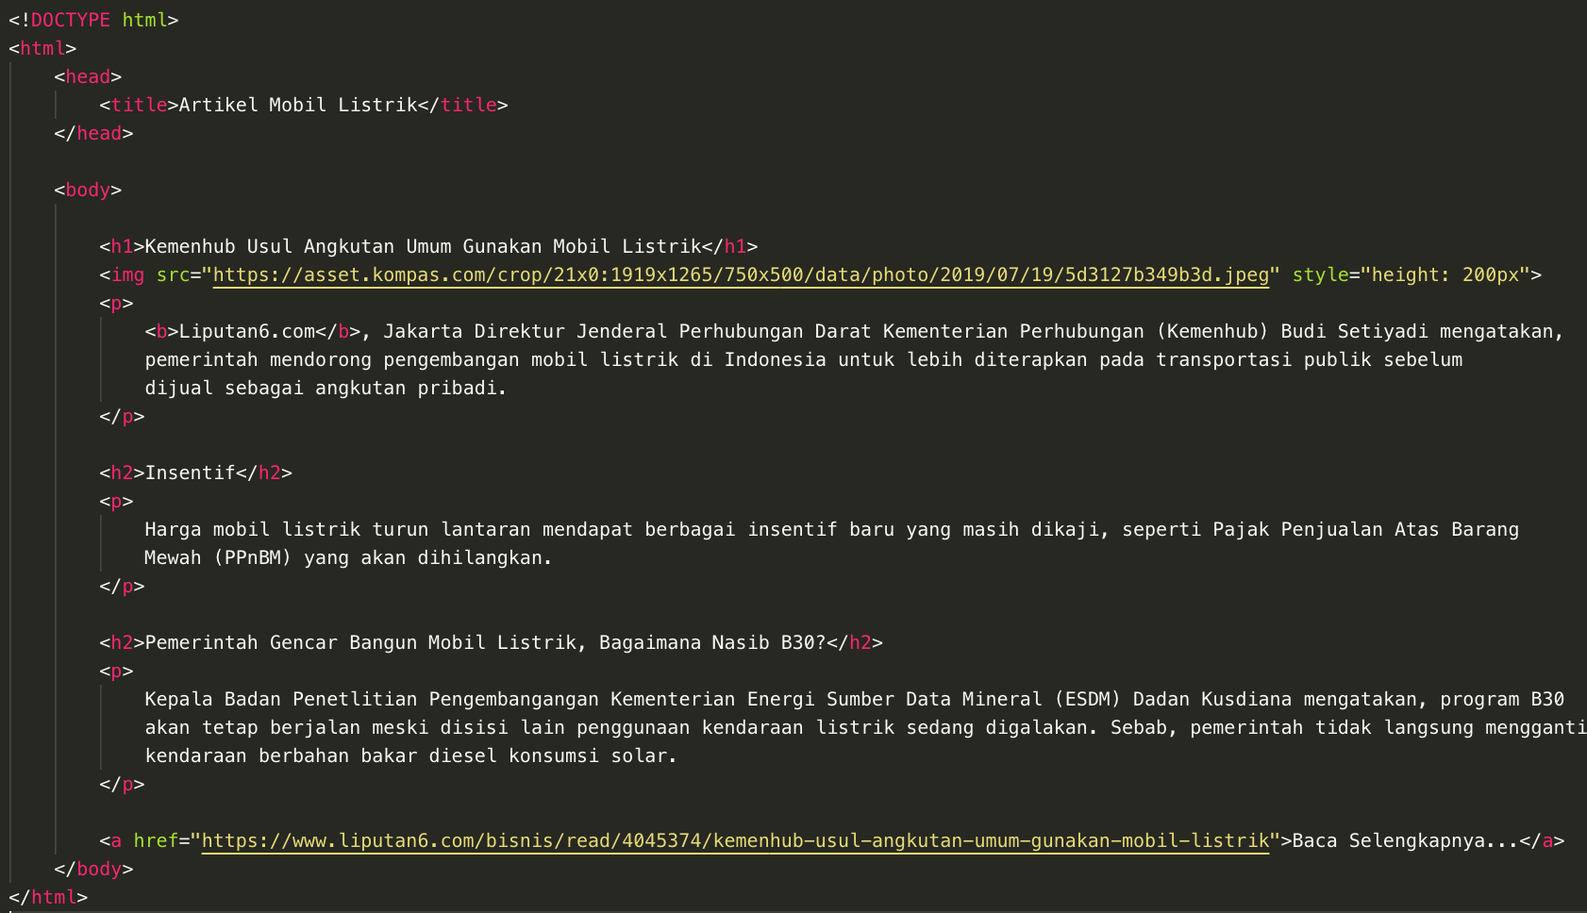
HTML Elements
<body>
<h1>
<img>
<h2>
<p>
<a>

Slide 33
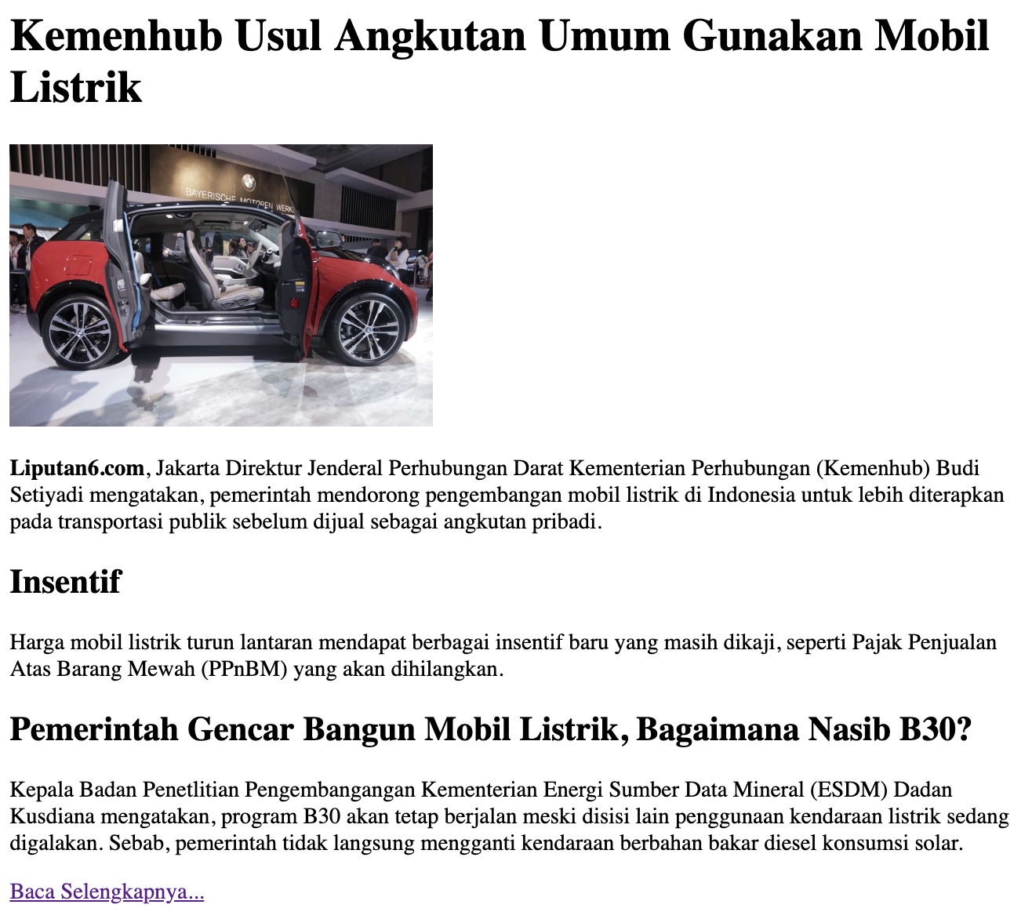
HTML Elements

Slide 34
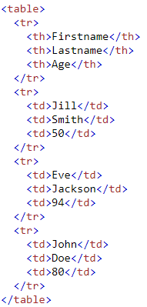
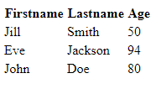
Table
Mobil-mobil yang akan menggunakan teknologi mobil listrik
No Mobil
1 Toyota
Daihatsu
Nissan

Slide 35
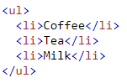
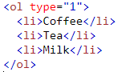
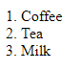
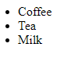
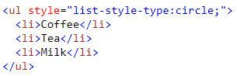
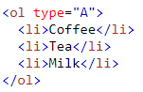
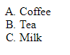
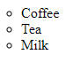
List

Slide 36
HTML Attribute

Slide 37
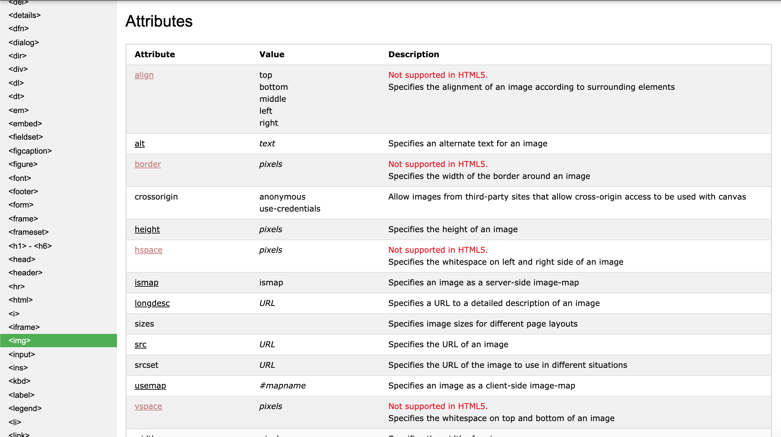
HTML Attribute
https://www.w3schools.com/tags/ref_attributes.asp

Slide 38
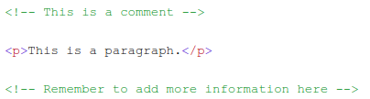
Comment

Slide 39
Keep practising!
Create HTML web article
https://health.detik.com/kebugaran/d-4678787/bingung-pagi-ini-olahraga-apa-ini-5-alasan-sehat-harus-pilih-bersepeda
References:
w3schools.com

Slide 40
Today’s lesson:
Course Overview
Programming Intro
JS Intro
Basic HTML
Create HTML
Use several basic tags

Slide 41
“Strive for progress not perfection.”
- Unknown

